Slide 1


Slide 2
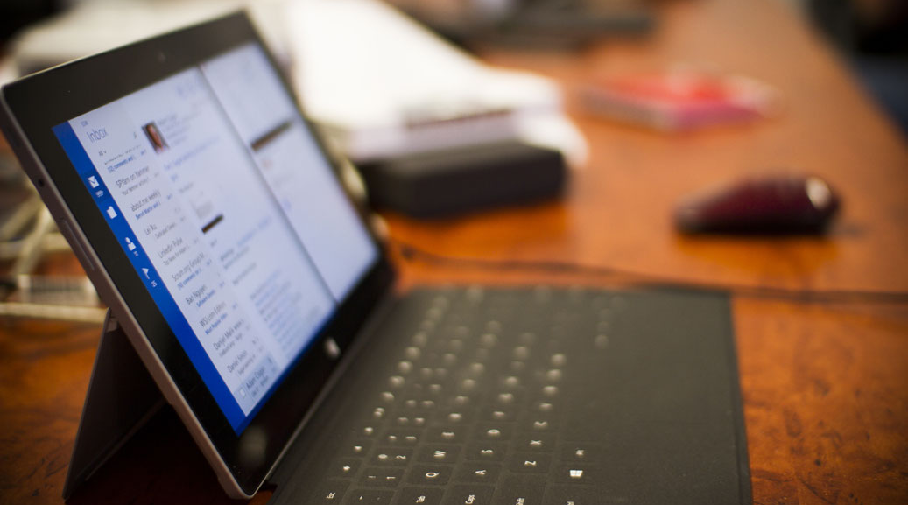
Getting started with Azure Machine Learning Service
AI Hack Day Online 2020 https://aihackday.com/

Slide 3
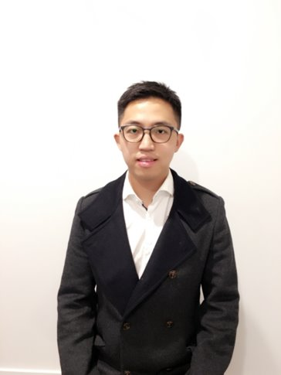
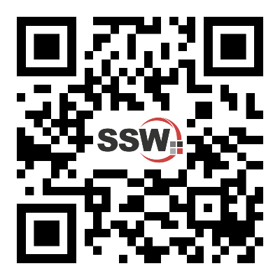


Patrick Zhao
Senior Software Architect @SSW
https://twitter.com/paladinapay
https://linkedin.com/in/patrickzhao1989
https://github.com/PatrickZhao1989
https://www.patrickzhao.co
Over 6 years experience in FinTech industry
Successfully delivered a number of data analytics and machine learning solutions
Enthusiast in machine learning and cloud technology (Azure)

Slide 4

Machine learning and deep learning framework
Agenda
Azure Machine Learning Service
Demo in VS Code
Notes:
Introduce JK
JK takes over screen sharing
Stay on this slide until JK has completed talk and Q&A

Slide 5
Machine Learning
Creation of algorithms which can modify itself without human intervention to produce desired output by feeding itself structured data​.

Slide 6
Machine Learning Workflow
Data feeding/ingestion
Feature engineering/data transformation
Model training
Model registration/versioning
Model serving

Slide 7
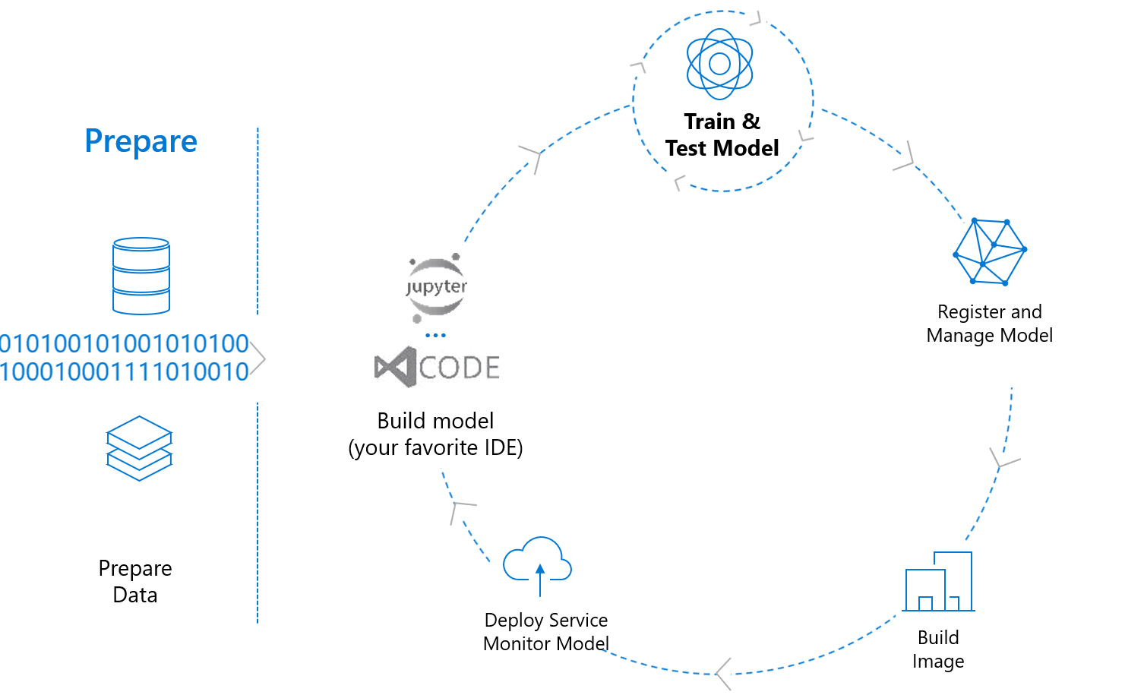
https://medium.com/microsoftazure/9-advanced-tips-for-production-machine-learning-6bbdebf49a6f

Slide 8
Azure Machine Learning Service
One stop workstation for machine learning
Wide range of productive experiences for building, training and deploying machine learning models faster
Best-in-class support for open-source frameworks and languages including ONNX, TensorFlow, PyTorch, Python and R

Slide 9
Demo
This demo uses TensorFlow to train an image classification machine learning model that categorizes handwritten digits from 0-9. It does so by creating a neural network that takes the pixel values of 28 px x 28 px image (784 pixels) as input and outputs a list of 10 probabilities, one for each of the digits being classified. Below is a sample of what the data looks like.
https://docs.microsoft.com/en-us/azure/machine-learning/tutorial-train-deploy-image-classification-model-vscode

Slide 10
Machine learning and deep learning framework
Summary
Azure Machine Learning Service
Demo in VS Code

Slide 11

Thank You
Questions

